Slide 1
Practical II
Monday/Tuesday, 3/4 February 2025, 2pm – 5pm
Department of Biology, University of Oxford

Slide 2

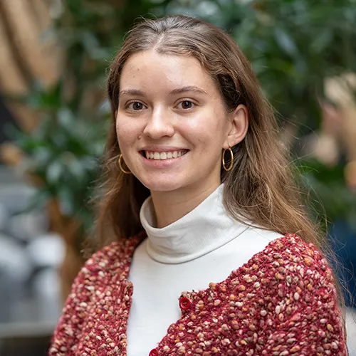
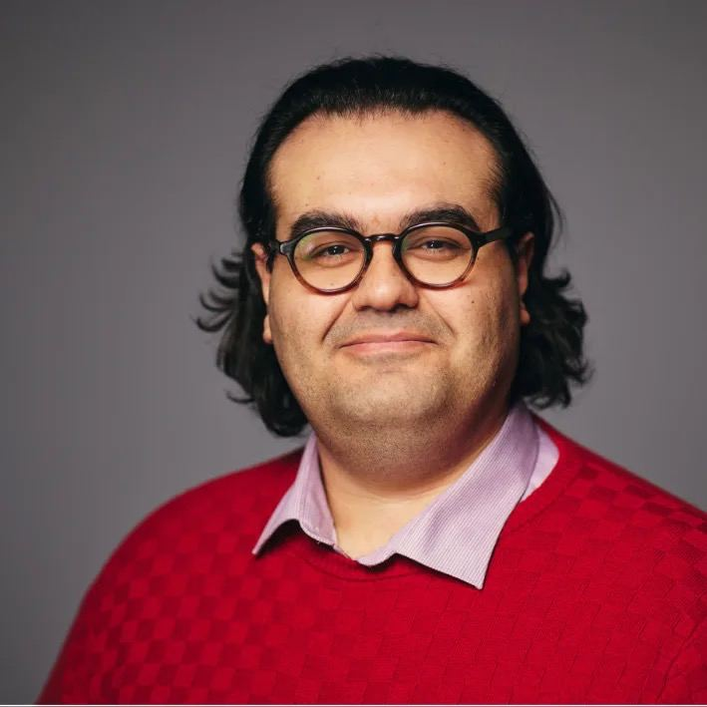

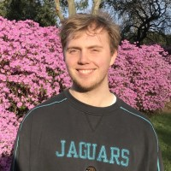
Demonstrators
Joseph, DPhil student in Biology (he/him)
Main research interests: Genomic epidemiology & disease surveillance
Rosario, DPhil student in health data science (she/her)
Main research interests: AI in infectious disease epidemiology and clinical research
Mahan, Wellcome Trust Early Career Fellow (he/him)
Main research interests: Molecular evolution of pathogens with pandemic potential
Moritz, Professor of Epidemiology (he/him)
Main research interests: Computational & genomic epidemiology of infectious diseases, global health
Rhys, DPhil student (he/him)
Main research interests: Genomic epidemiology, climate-sensitive diseases

Slide 3
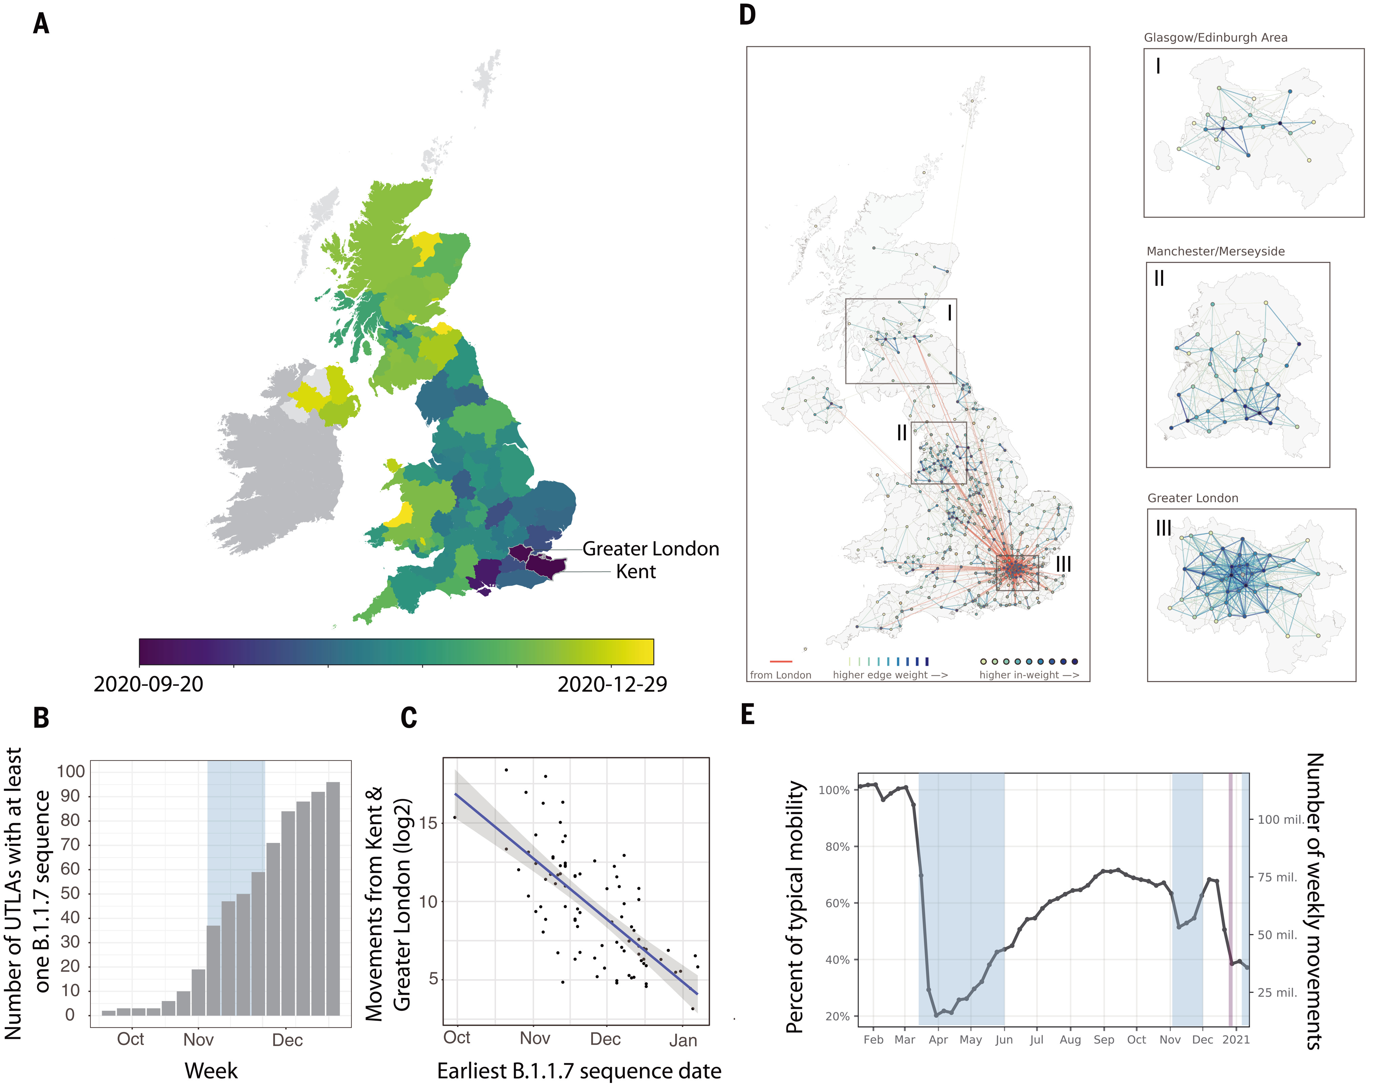
What are we learning today?
Spatiotemporal dynamics of plant and human infectious diseases
How to fit models to data and evaluate which one explains the data best (for plant diseases)
Differences between human mobility driven dispersal vs. continuous diffusion (distance based)
How to incorporate spatial structure in epidemic models for flu
Kraemer et al. 2021 Science

Slide 4
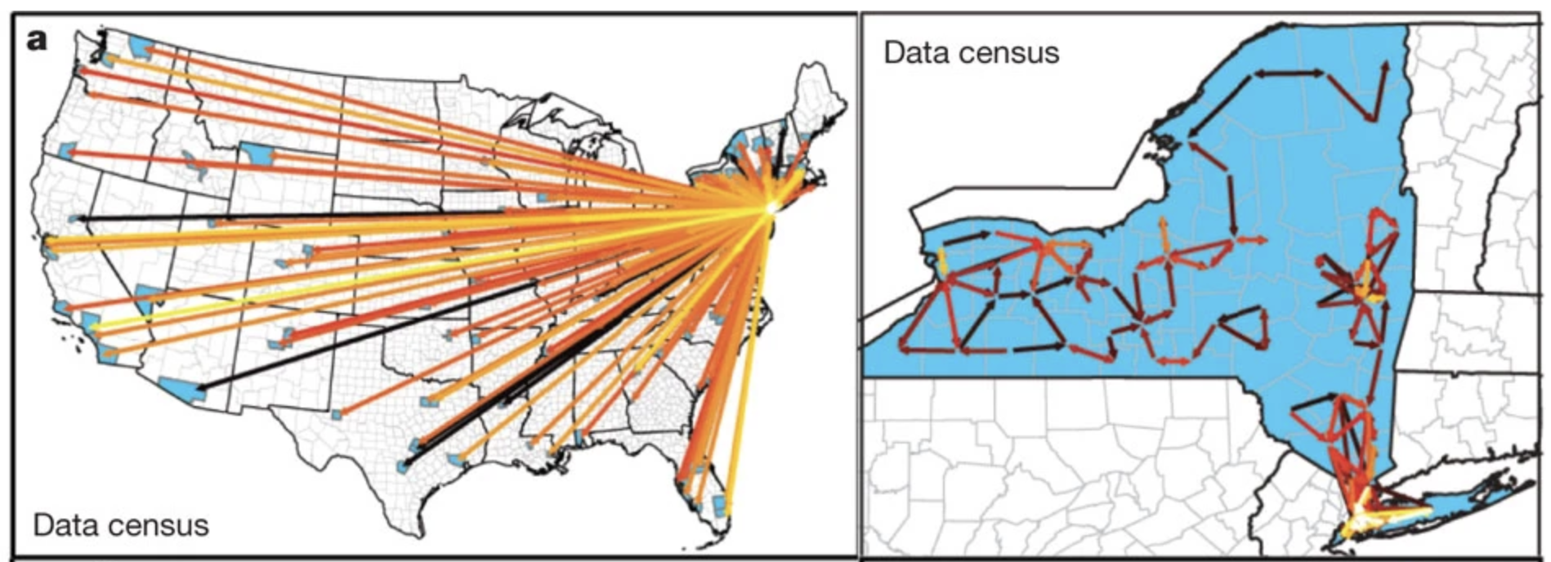
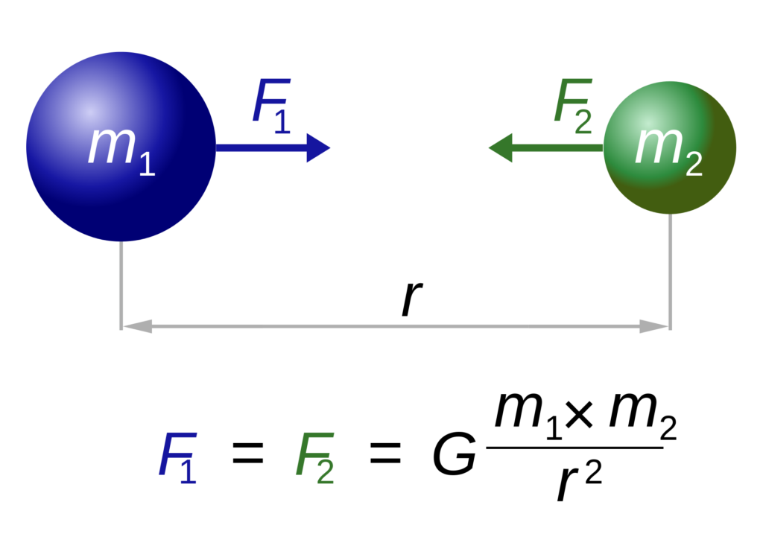
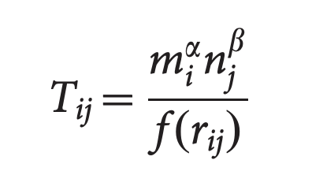
Models of human mobility
Infectious diseases spread along human movement networks
Challenge: how do we represent human movement in ID models?
The gravity model
Simini et al. 2017 Nature

Slide 5
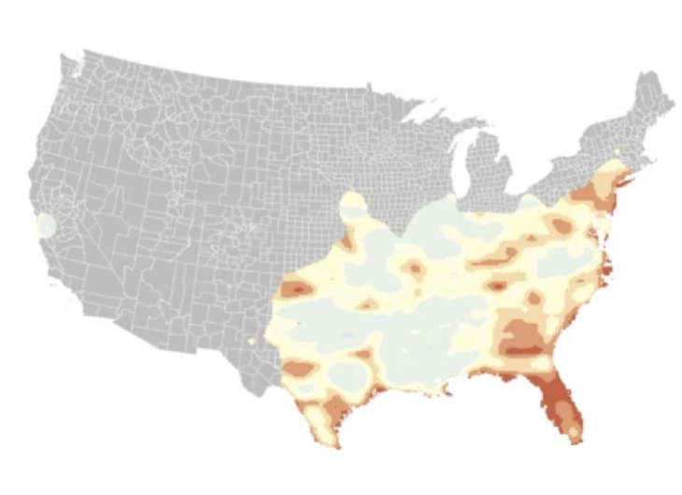
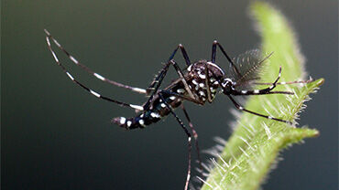
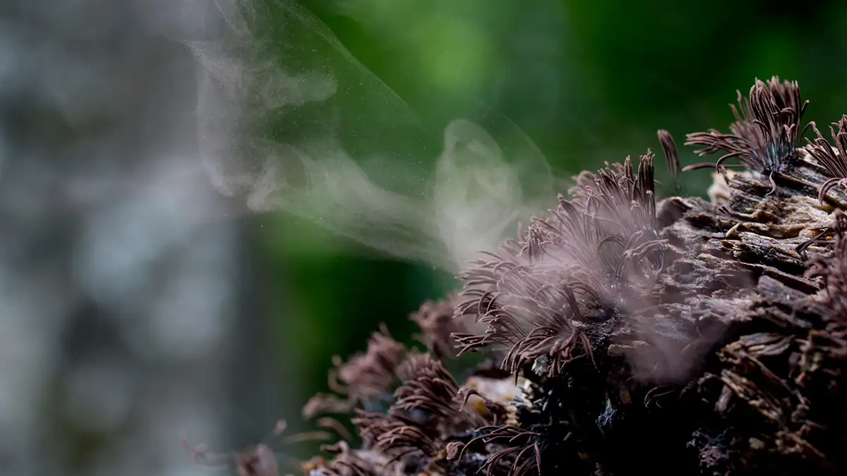
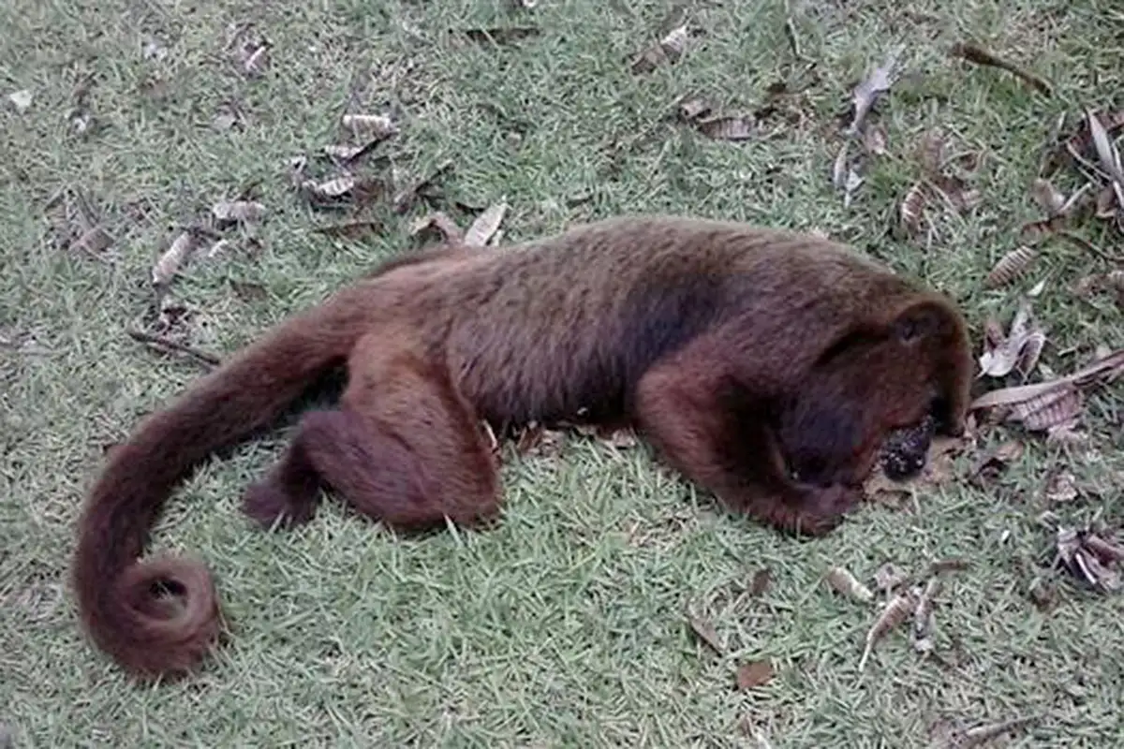
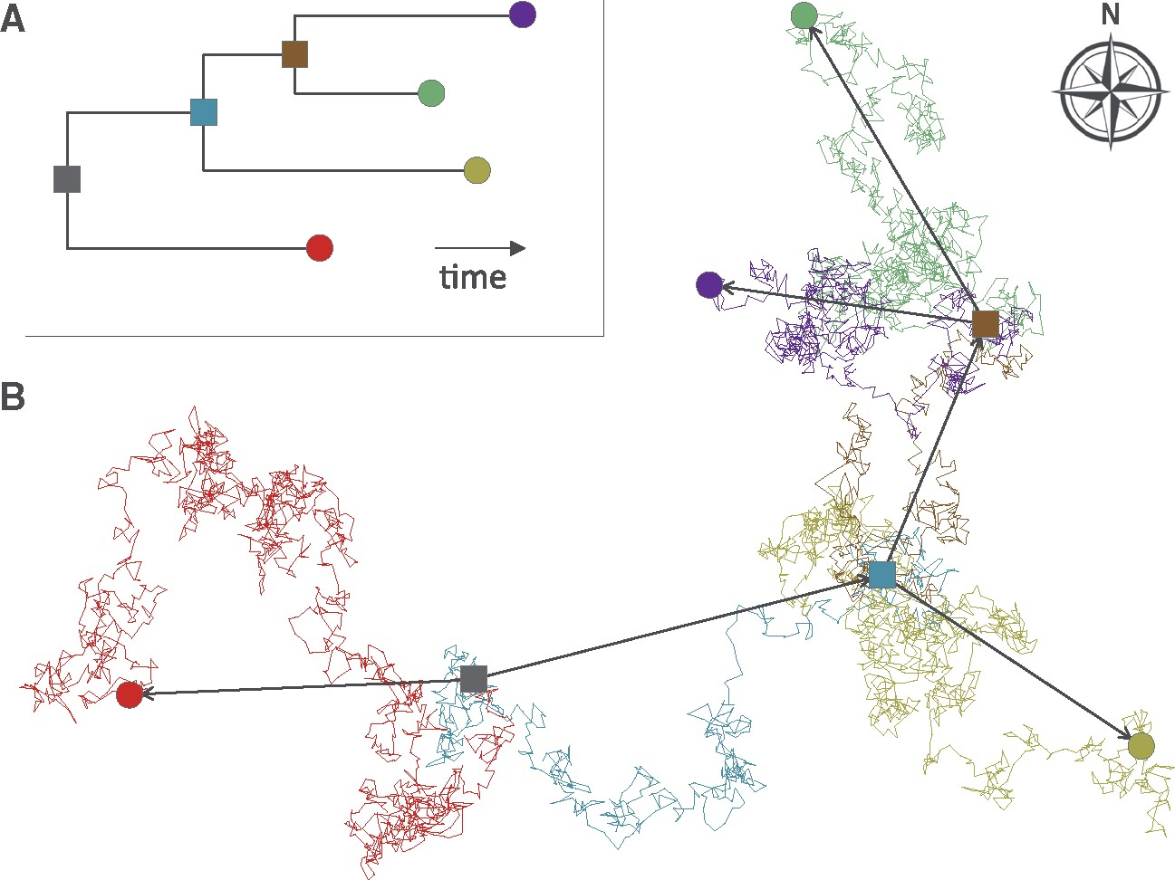
Examples of continuous diffusion
Aedes aegypti
Fungal spores
Kraemer et al. 2019 Nat. Microbiology
Primates

Slide 6
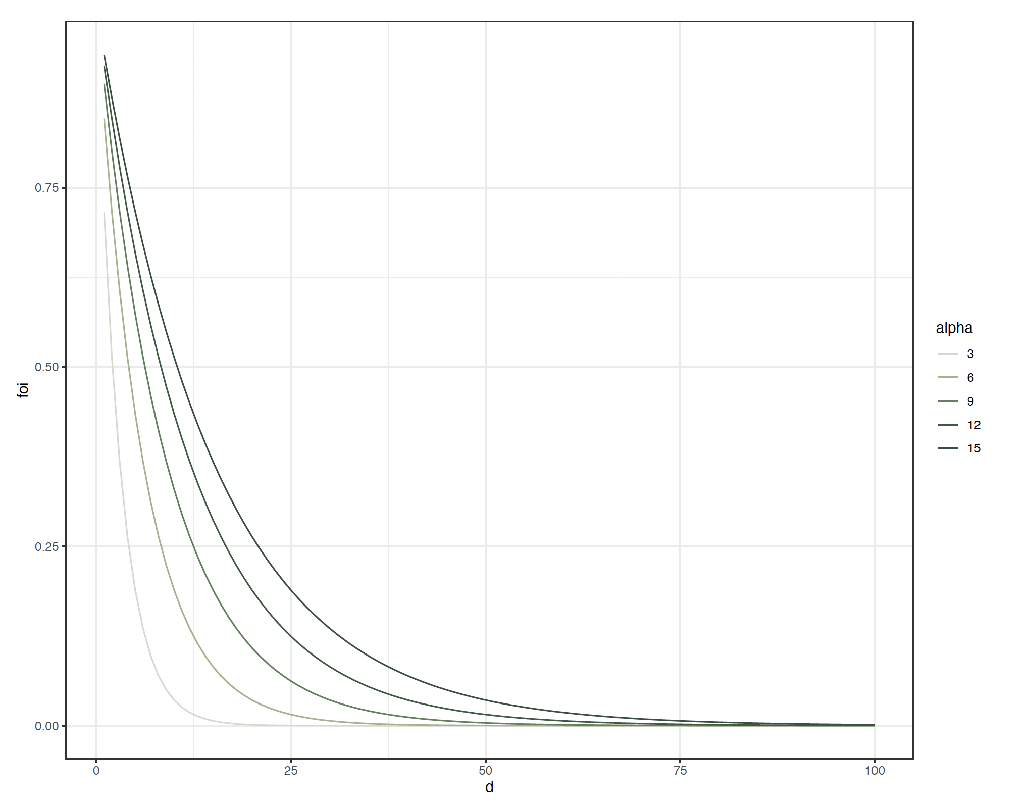
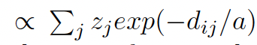
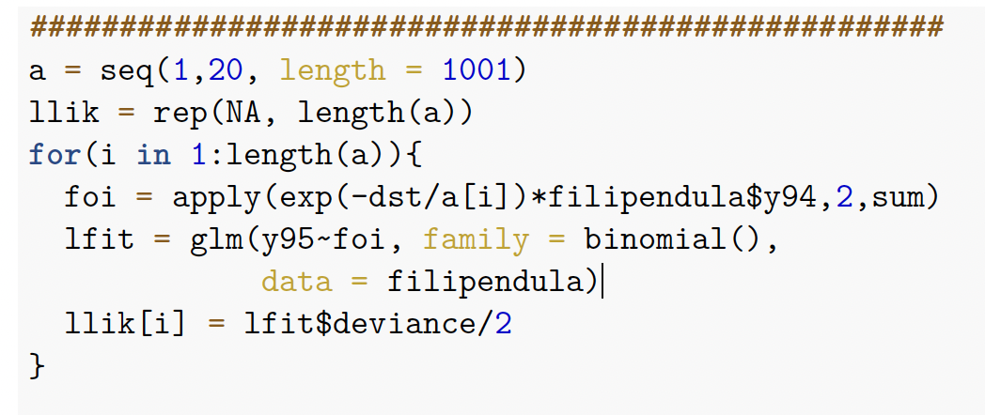
Spatial force of invasion
Exponential kernel
Increasing $a$
$$a$$

Slide 7

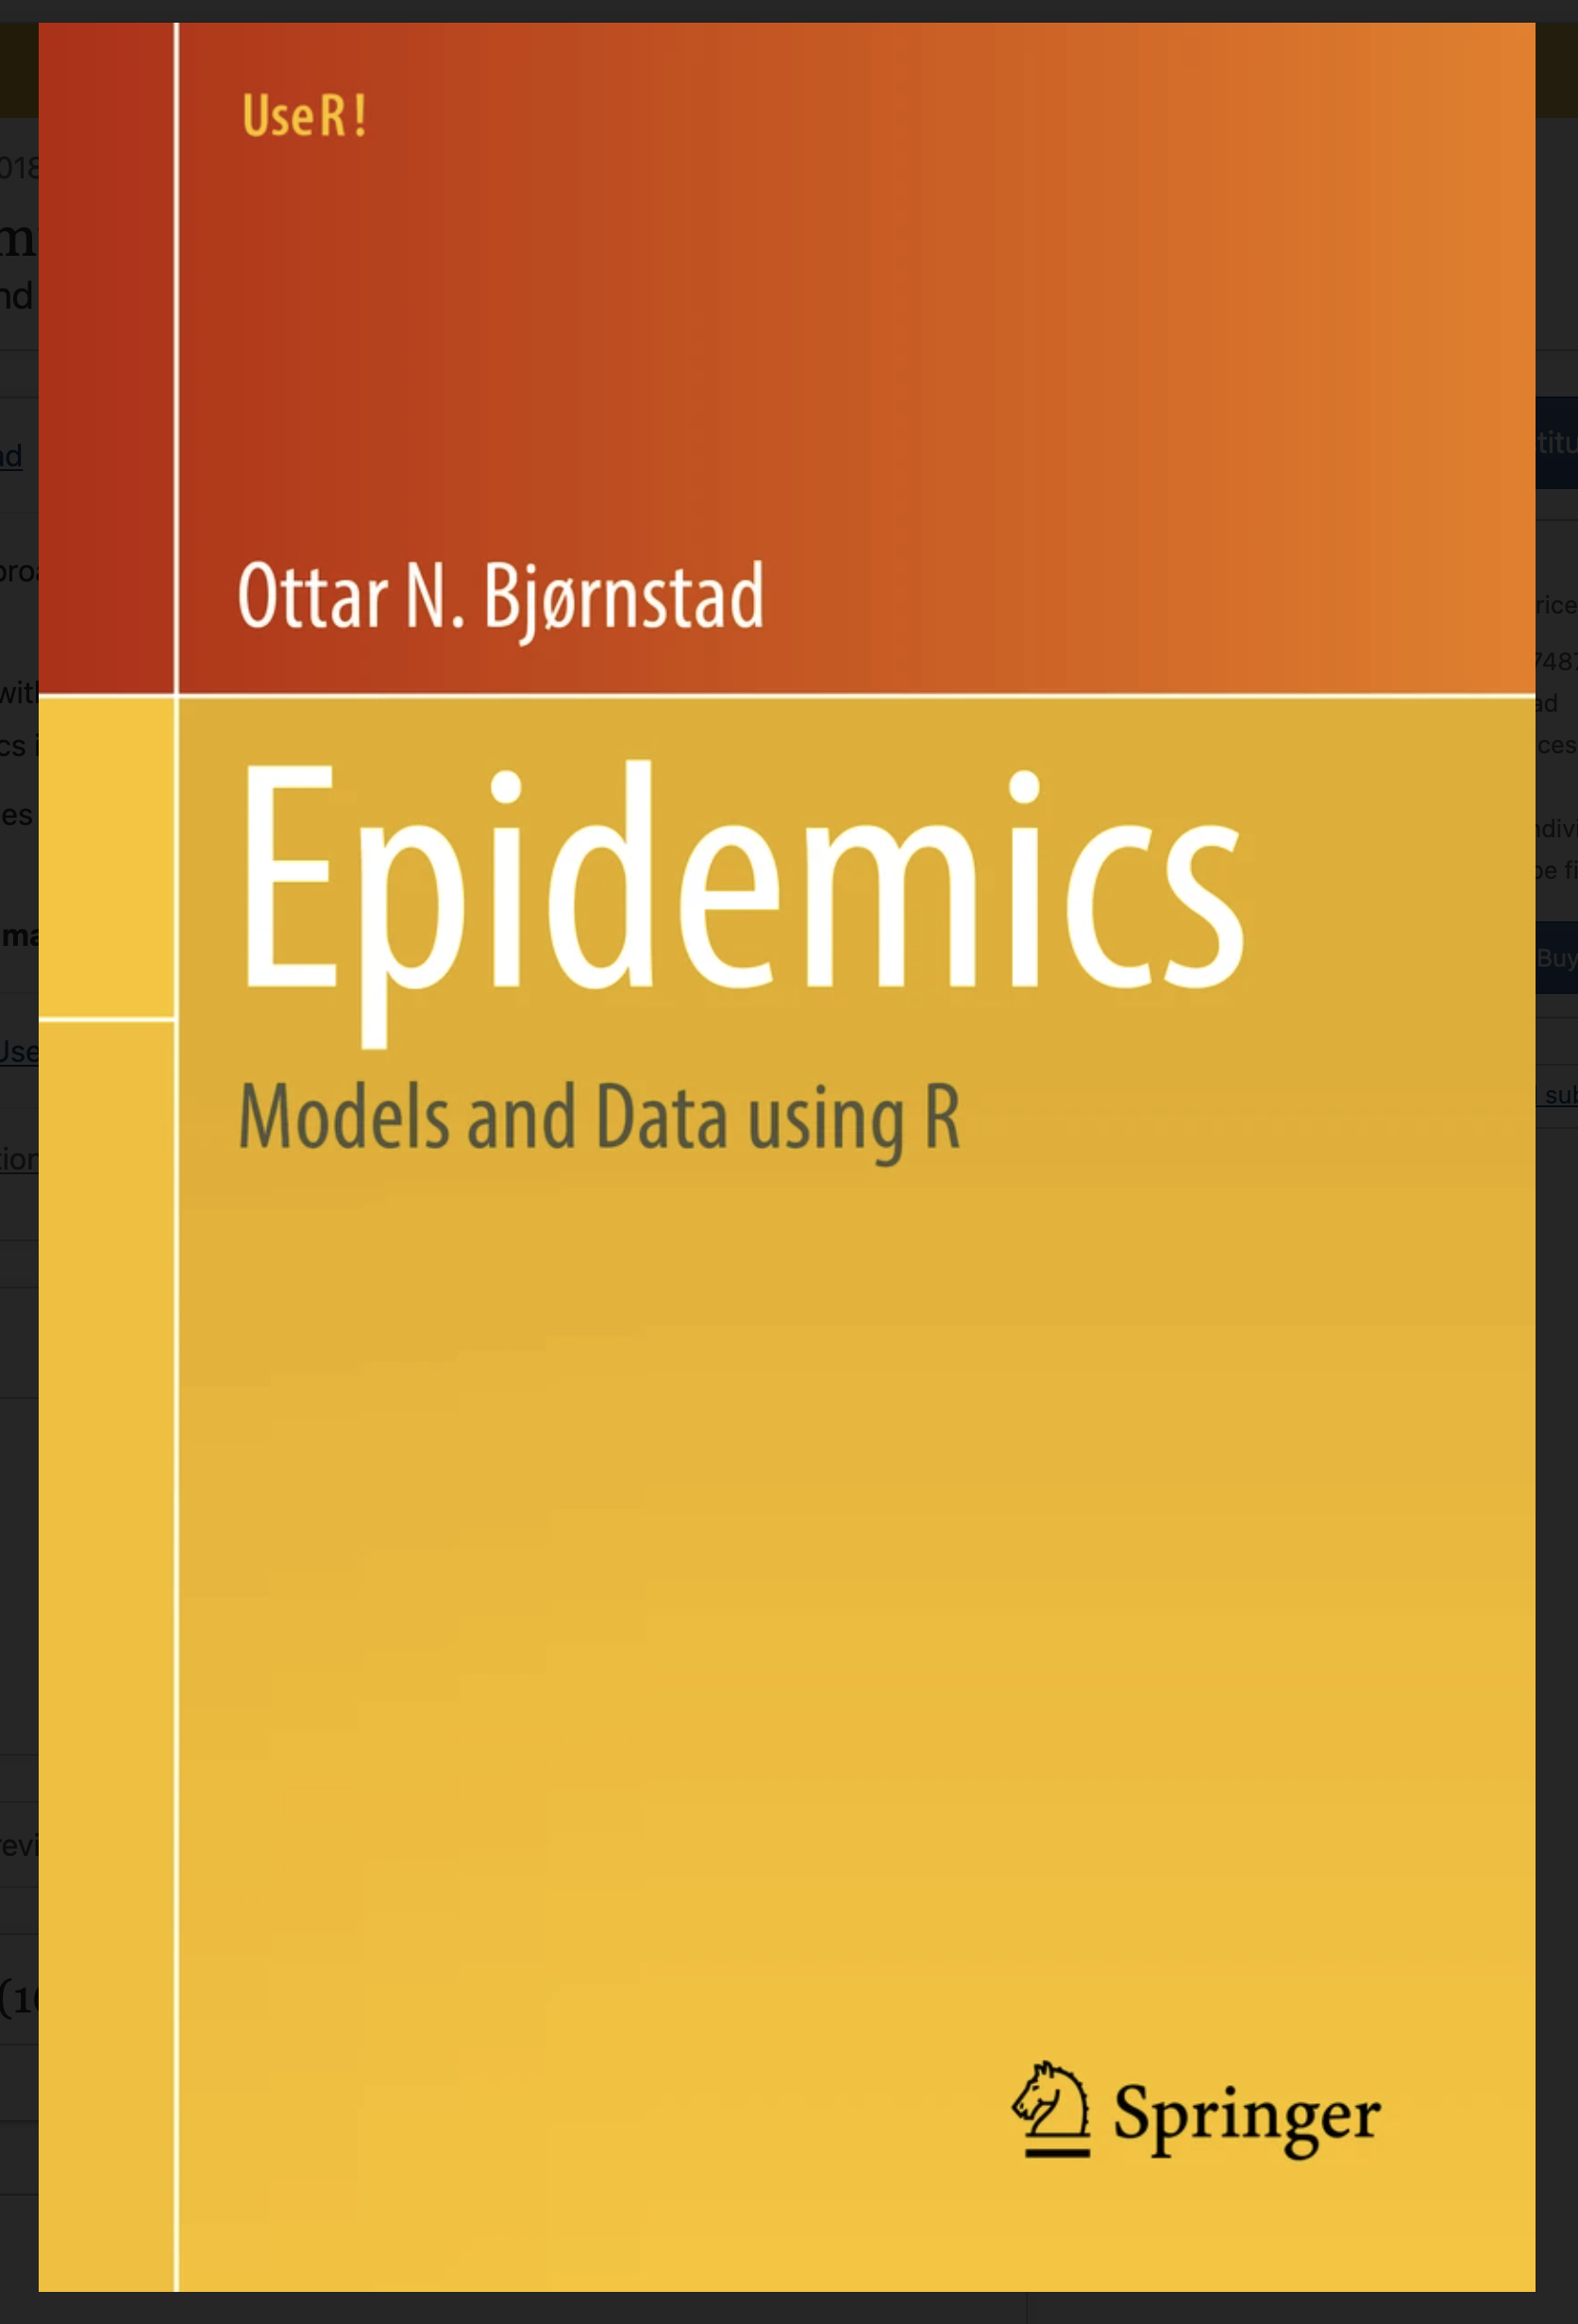
Some further readings
https://github.com/kraemer-lab/Mbiol-Practical-2025
https://link.springer.com/book/10.1007/978-3-319-97487-3
https://www.statlearning.com/

